Slide 1


Patient Waiting Time Analysis and Optimization in Hospital Using Business Analytics
A Research Project on Enhancing Healthcare Efficiency through Data-Driven Insights
Name of the Student
Specialization
Hospital
Pranav Umakant Biradar
MBA 1 (Business Analyst)
Dr.Karad Hospital,Nashik.
Name of the Guide
Academic Year
Dr. Radhika Khairnar
2025-2026
Dr. Moonje Institute of Management & Computer Studies, Nashik

Slide 2


Introduction
The Challenges
Business Analytics Role
Patient waiting time is a critical indicator of healthcare quality and patient satisfaction.
Leveraging data mining and predictive modeling to identify hidden bottlenecks in the system.
Prolonged delays lead to patient frustration and can negatively impact clinical outcomes.
Using statistical analysis to optimize staffing levels and scheduling based on patient arrival patterns.
Inefficient patient flow often results in resource underutilization and increased operational costs.
Transforming raw hospital data into actionable insights for operational excellence.
Dr. Moonje Institute of Management & Computer Studies, Nashik

Slide 3
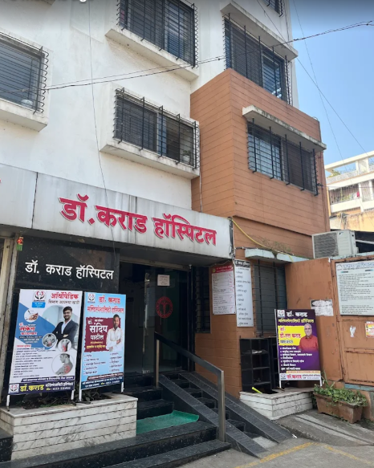
Hospital Profile
Dr. Karad Hospital is a healthcare institution located in Satpur, Nashik, providing medical services to patients from nearby urban and rural areas. The hospital offers various healthcare facilities including outpatient consultation, registration, diagnostic services, treatment, and billing services.
The hospital focuses on delivering quality healthcare services with proper patient care and operational efficiency. Due to increasing patient flow and service demand, managing patient waiting time and maintaining smooth hospital operations have become important aspects of hospital management.
The hospital uses both manual and digital processes for patient management and service delivery. The study was conducted in this hospital to analyze patient waiting time, identify operational inefficiencies, and suggest optimization strategies using business analytics techniques.
Dr. Moonje Institute of Management & Computer Studies, Nashik

Slide 4

Objectives of the Study
To analyze the waiting time at different stages of the hospital service process, including registration, consultation, diagnostic services, pharmacy, and billing, in order to identify the major sources of delay
To identify the operational factors responsible for increased patient waiting time, such as patient flow, staff availability, resource utilization, appointment scheduling, and process inefficiencies.
To apply business analytics techniques for evaluating hospital operations and recommend data-driven strategies to optimize workflows, reduce waiting time, and improve operational efficiency.
To assess patient satisfaction regarding hospital waiting time and service quality, and examine how waiting time influences the overall patient experience and healthcare delivery
Dr. Moonje Institute of Management & Computer Studies, Nashik

Slide 5




Literature Review
Current Trends
Technological Integration
Studies indicate that over 30% of patient dissatisfaction stems from long waiting periods, highlighting wait time as a primary quality metric in modern healthcare.
The integration of Business Intelligence (BI) tools and AI enables real-time patient tracking and predictive resource allocation to mitigate delays.
Analytical Frameworks
Gap Analysis
Previous research emphasizes the efficacy of Queuing Theory and Lean Six Sigma methodologies in streamlining hospital workflows and reducing non-value-added time.
There is a significant need for localized studies in Indian management contexts to address specific infrastructural challenges and cultural arrival patterns.
Dr. Moonje Institute of Management & Computer Studies, Nashik

Slide 6





Research Methodology
Research Design
Data Collection
A combination of Descriptive and Analytical research designs to understand current patterns and identify optimization opportunities.
Primary:
Observation,Patient Feedback,Staff Intereaction,Google Form.
Secondary:
Research journals,WebsitesPrevious research papers on waiting time analysis and healthcare analytics.
Analytical Tools
Sampling Technique
Statistical:
Pivot Tables,Comparative Analysis
Convenience sampling technique was used for the study. The respondents were selected based on their availability and willingness to participate during the hospital visit.
Visualization:
Excel,Bar Charts,Pie Charts,Column Charts, PowerBi,Donut Charts.
Dr. Moonje Institute of Management & Computer Studies, Nashik

Slide 7
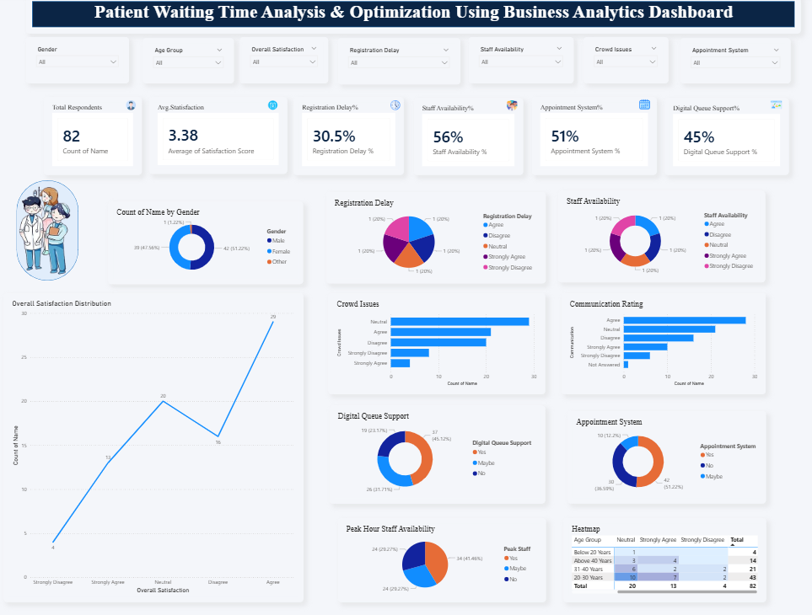



Data Analysis and Interpretation
The dashboard was created using Power BI, Pivot Tables, Pivot Charts, and Slicers to analyze patient waiting time and hospital operational efficiency dynamically.
The dashboard provides visual insights regarding patient demographics, waiting time satisfaction, crowd management issues, digital queue system support, registration delays, appointment system effectiveness, and staff availability impact.
Interactive slicers were used to filter data dynamically based on age group, gender, and patient responses. The dashboard helps in identifying operational bottlenecks and supports data-driven decision-making for improving hospital service efficiency.
Dr. Moonje Institute of Management & Computer Studies, Nashik

Slide 8
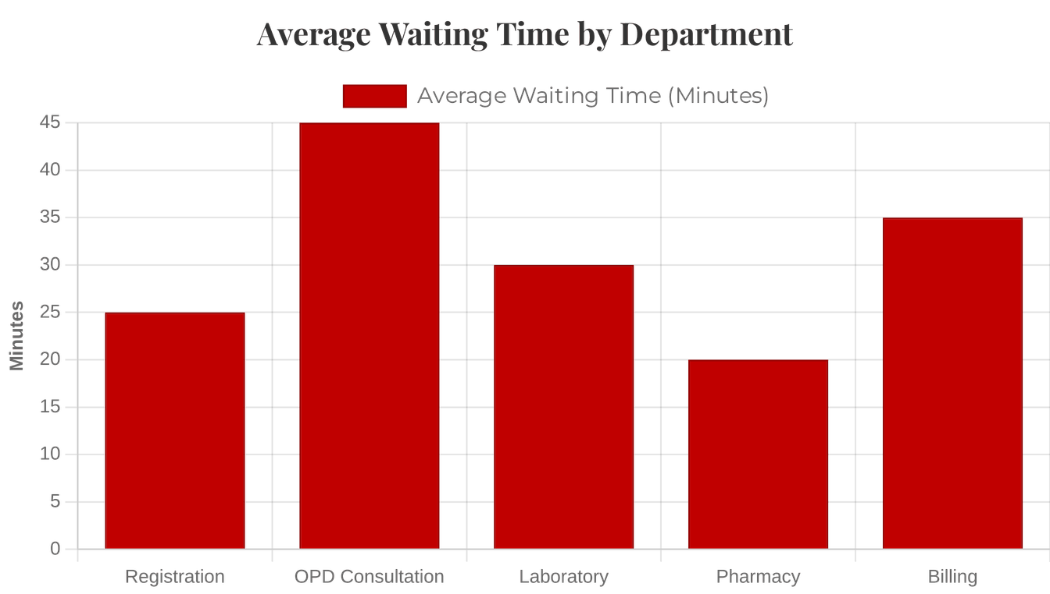
Data Analysis and Interpretation
Waiting Time Distribution
Significant variance observed across departments, with OPD and Billing showing the highest delays.
Correlation Analysis
A positive relationship is observed between patient arrival volume and total processing time. As patient arrivals increase, processing time also tends to increase.
Peak Hour Identification
Data identifies 10:00 AM - 1:00 PM as the critical peak period requiring maximum resource allocation.
Dr. Moonje Institute of Management & Computer Studies, Nashik

Slide 9




Findings / Results
Registration Bottlenecks
Staffing Mismatch
Registration and billing processes are the primary bottlenecks, accounting for approximately 40% of total patient wait time.
Peak patient arrival times often do not align with maximum staff availability, leading to significant service delays during high-demand periods.
Process Redundancy
Satisfaction Impact
Duplicate data entry points across different departments contribute to unnecessary administrative delays and increased error rates.
A direct inverse correlation exists between wait time and patient satisfaction scores, with a sharp decline after the 30-minute mark.
Dr. Moonje Institute of Management & Computer Studies, Nashik

Slide 10



Conclusion
"Business analytics provides a powerful lens to transform hospital operations from reactive to proactive, ensuring that patient care remains the central priority."
Operational Summary
Quality Impact
Final Thought
Optimization through data-driven insights significantly reduces wait times and enhances patient flow across all departments.
Reduced waiting times directly correlate with improved clinical outcomes and higher patient satisfaction scores.
Data-driven decision-making is no longer optional but essential for the sustainability of modern healthcare management.
Dr. Moonje Institute of Management & Computer Studies, Nashik

Slide 11




Optimization Suggestions
Predictive Scheduling
Digital Transformation
Utilize historical data to forecast patient arrival patterns and align staffing levels dynamically with peak demand periods.
Implement self-service kiosks and mobile registration platforms to decentralize the intake process and reduce front-desk congestion.
Process Re-engineering
Real-time Monitoring
Adopt Lean Six Sigma principles to identify and eliminate non-value-added steps, streamlining the end-to-end patient journey.
Deploy interactive BI dashboards for administrators to monitor live patient flow and intervene immediately when bottlenecks occur.
Dr. Moonje Institute of Management & Computer Studies, Nashik

Slide 12




Learning from Project
Analytical Skills
Domain Knowledge
Problem Solving
Professional Growth
Gained hands-on proficiency in data collection, cleaning, and advanced visualization techniques using Excel and BI tools.
Deepened understanding of healthcare operations, patient flow dynamics, and hospital experience management.
Learned to apply theoretical business analytics concepts to solve complex, real-world operational challenges in a hospital setting.
Developed critical insights into the strategic role of a Business Analyst in driving efficiency within the healthcare sector.
Dr. Moonje Institute of Management & Computer Studies, Nashik

Slide 13
References
1)Gupta, S. (2021). Hospital Operations Management and Patient Flow Optimization. New Delhi: Healthcare Publications. 2) Sharma, R. & Kulkarni, P. (2020). “Impact of Waiting Time on Patient Satisfaction in Hospitals.” International Journal of Healthcare Management, Vol. 8, No. 2, pp. 45–52. 3)Kumar, V. (2019). Business Analytics for Healthcare Management. Mumbai: Himalaya Publishing House. 4)Ghosh, S. (2022). “Role of Queue Management Systems in Hospital Service Efficiency.” Journal of Hospital Administration, Vol. 12, No. 3, pp. 78–86. 5)Jain, A. & Mehta, R. (2021). “Patient Waiting Time Analysis Using Data Analytics.” International Journal of Business Analytics and Intelligence, Vol. 5, No. 1, pp. 21–29. 6)World Health Organization (WHO). (2022). Healthcare Service Quality and Patient Satisfaction Report. Geneva: WHO Publications.
Dr. Moonje Institute of Management & Computer Studies, Nashik

Slide 14

THANK YOU
Name of the Student
Pranav Umakant Biradar
Specialization
MBA 1 (Business Analyst)
Roll No.
254
Name of the Project Guide
Dr. Radhika Khairnar
Dr. Moonje Institute of Management & Computer Studies, Nashik

